Slide 1

MEDICINE EXPRESS
e-Healthcare Management System
CS 5200 Project
Nikhil Kumar Pulipeta [700727975]
Sandhya Kamisetty [700723853]
Nikita Mathukumilli [700725375]

Slide 2
Domain Knowledge
Medicine Express project is a Pharmacy Management System which is developed for establishment of Medical stores in the city.
To manage all operations of the medical store this project is being developed.
It will have the entire basic modules to manage the medical store operations and patient-doctor history.

Slide 3
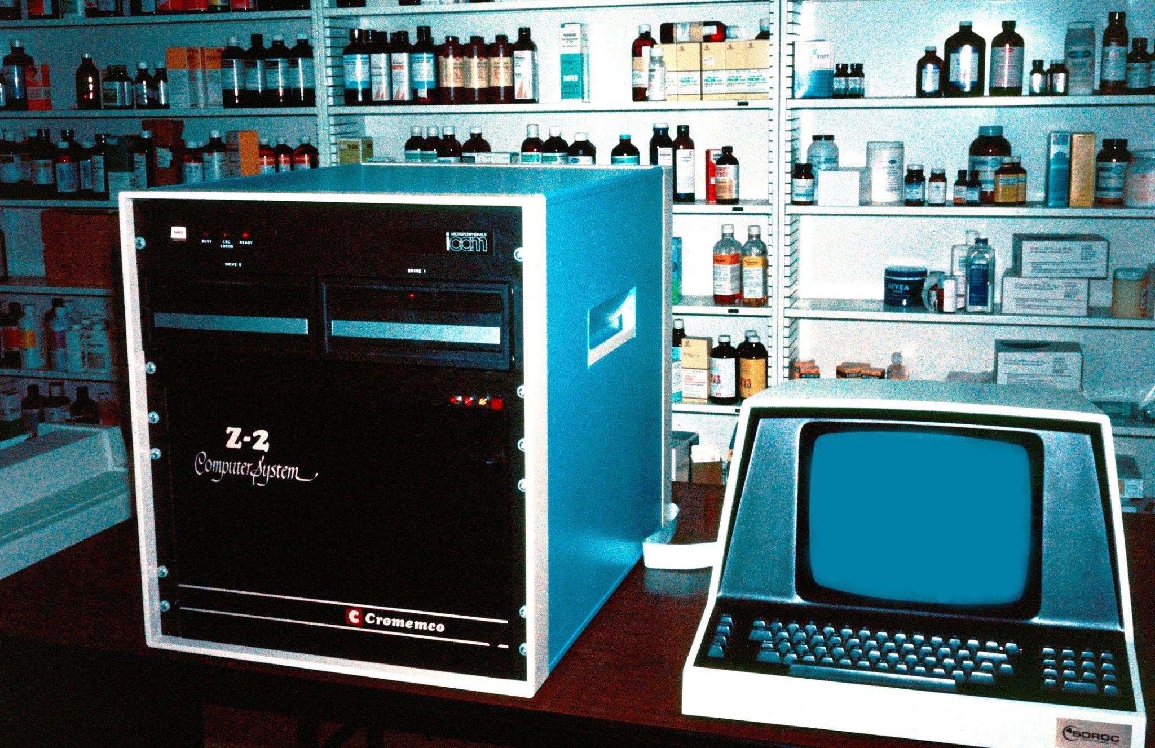
Existing System
Currently, the medical works are based on the manual process, and each work is maintained in the paper.
The details of purchasing drugs, audits, store transactions were maintained on the paper. while, anyone can enter into the system and can make changes in these reports, so it is not a safe method to keep the information on the paper.
The pharmacist face problems in searching the products from the shelf. As it is not an easy method to remember about the place of each medicine. There is no Pharmacy Management System which can alert the pharmacist about the end of the drugs.

Slide 4
Objectives
The main objective of the application is to automate the existing system of manually maintained records of the counter sales, purchases, reorder levels, Supplier and Customer monetary positions and other related transactions made by the seller.
We are using bar graph to indicate the sales growth for a medical store, which helps to grow his business.

Slide 5

Functional Requirements
Administrator
Medical Store
Doctor
Patient

Slide 6
Administrator Module
Add Category
Add Sub-Category
View Medicine
Add Medical Store
View/Activate/Deactivate Medical Stores & Medicines
Add Doctor

Slide 7
Medical Store Module
Login/Register
Add/update/delete Medicines
View Medicines in the Store
View all Medicines to be Added
View orders/accept orders
View bar graph/x date/y income

Slide 8
Doctor Module
Register
Login
View patient with UHID
Write Prescription
Add patient reports

Slide 9
Patient Module
Register
Login
View Doctor
Search Doctor by name/speciality
View Prescriptions
Add/update/remove cart
Order medicines
View ordered Medicines
Pickup orders

Slide 10
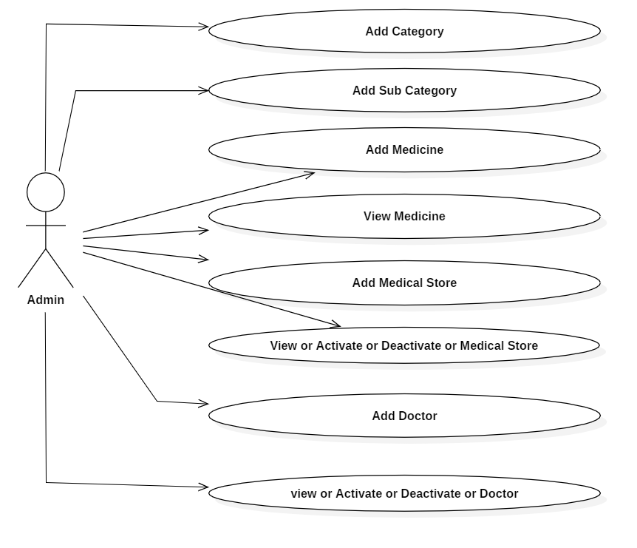
Use Case Diagram
Administrator

Slide 11
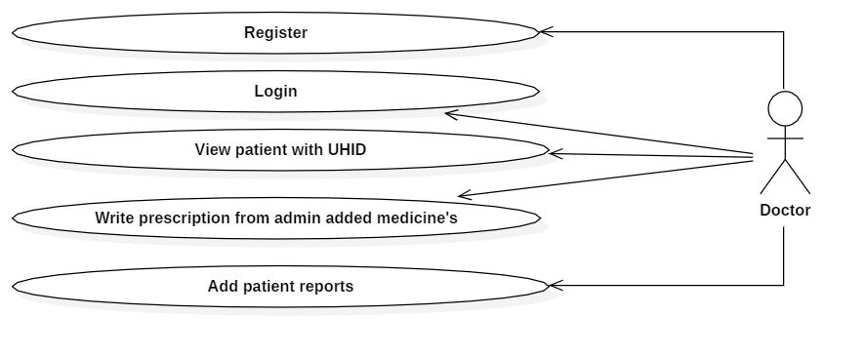
Doctor
x

Slide 12
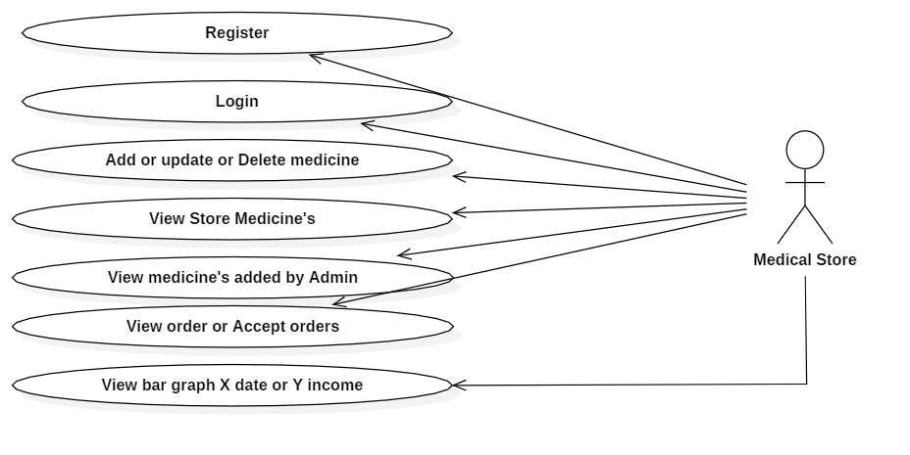
Medical Store
x

Slide 13
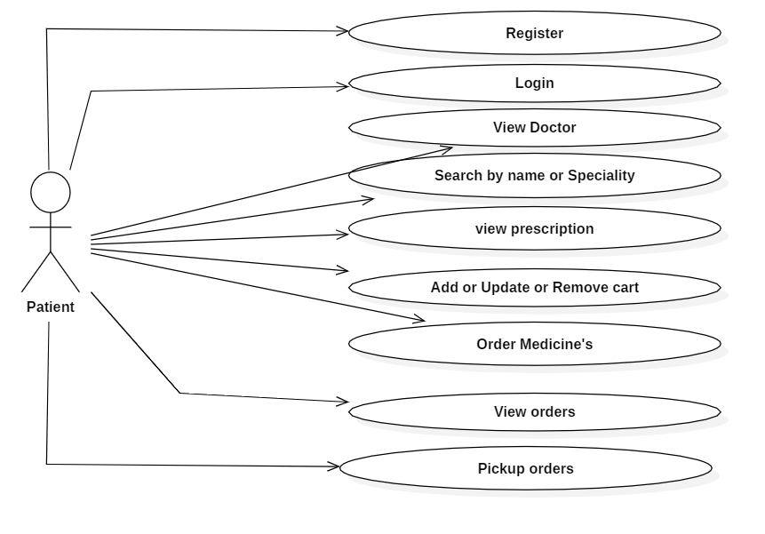
Patient
i

Slide 14
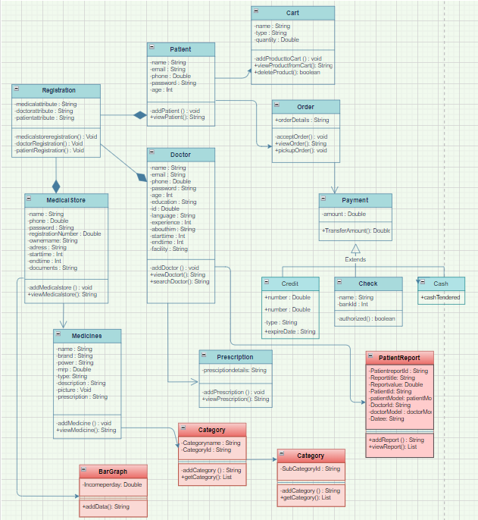
Class Diagram

Slide 15
Algorithms
Searching
When we have list of Doctor names with Speciality, We use linear search to get doctor name by comparing search string as substring.
Sorting
In the View pages of all modules, we use default Collections sorting method to sort according to UHID or price in order’s list.

Slide 16
Data Structures
Arrays
We are storing list of UHID (Patient ID - Integer) in array. Which will be useful to process easily for operations like searching and sorting
Hash Tables
For faster viewing of data we need to get data in O(1)
So we store patient data in Hash map with UHID as Key and patient details as value.

Slide 17
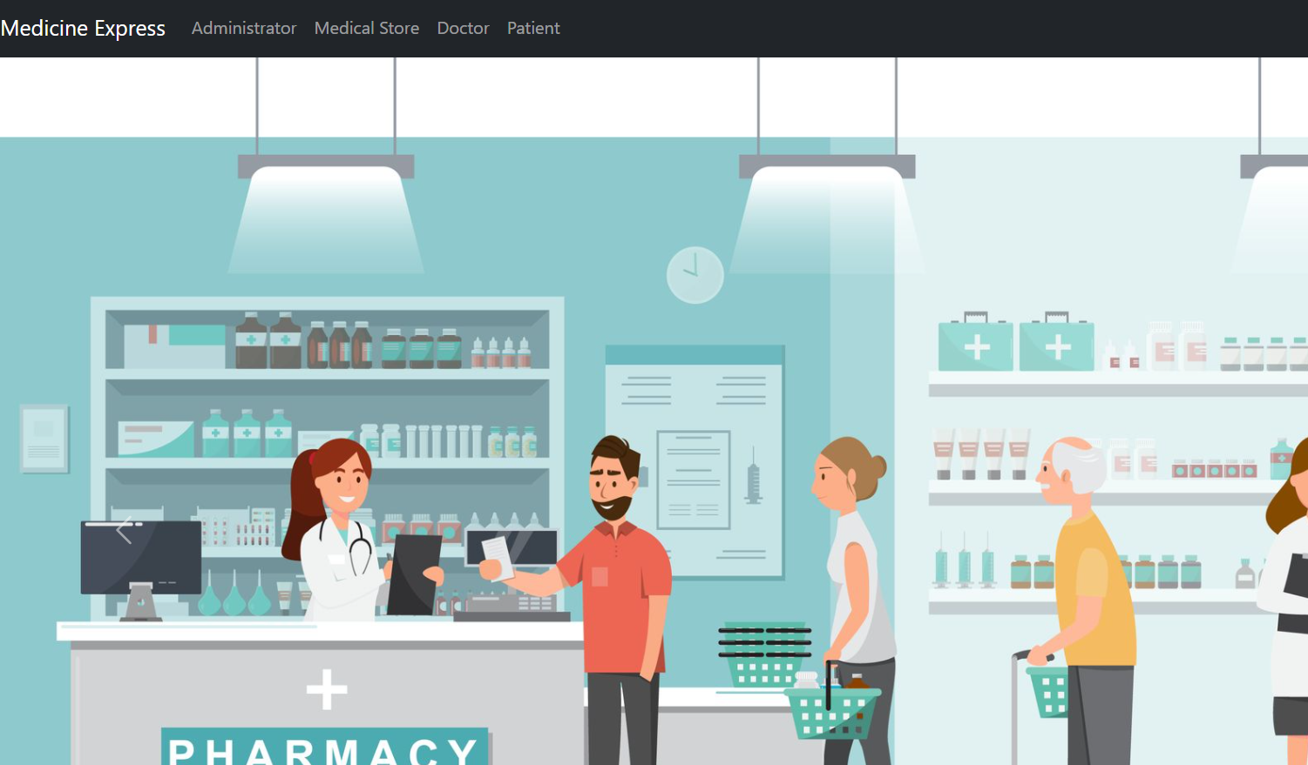
HOME PAGE

Slide 18
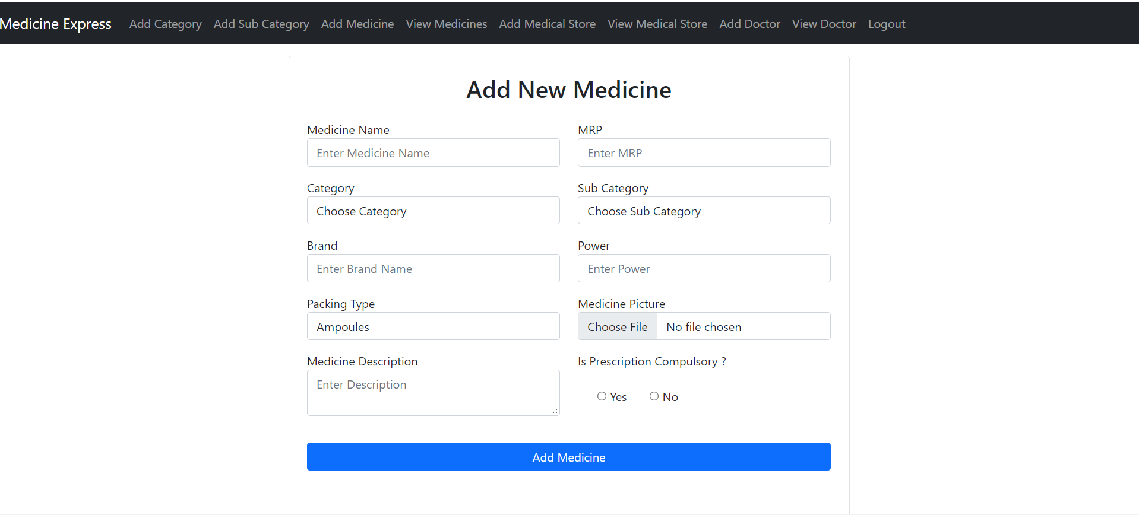
ADMIN ACCESS PAGE

Slide 19
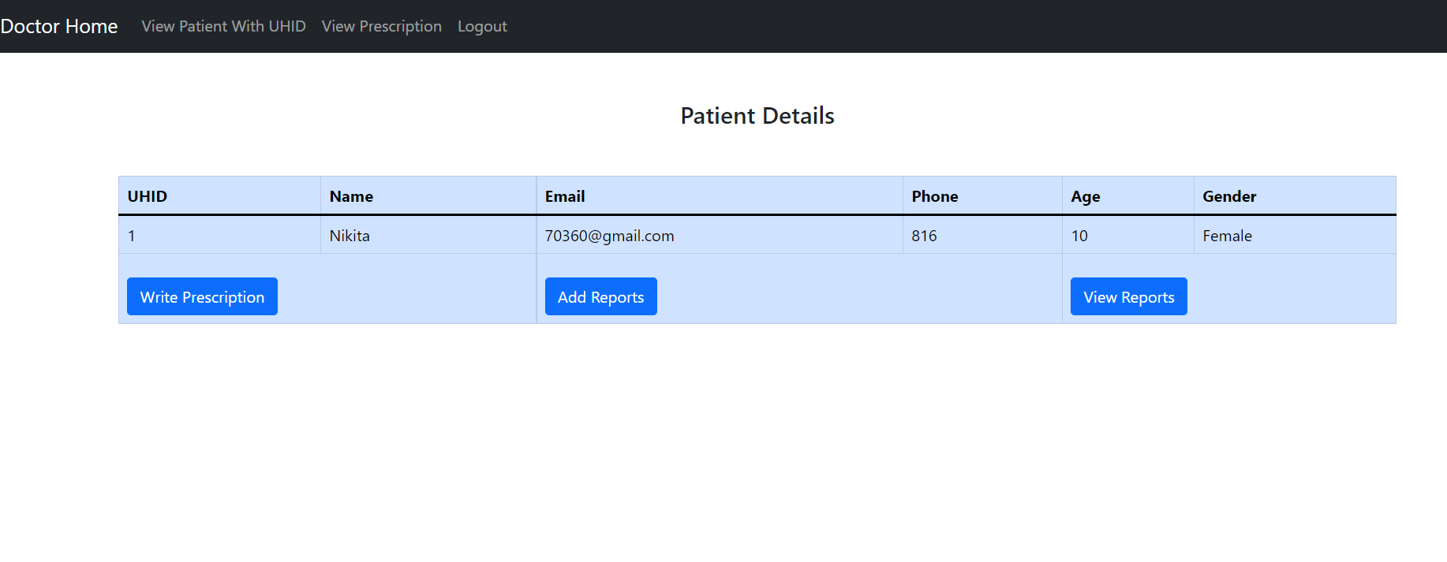
DOCTOR HOME PAGE

Slide 20
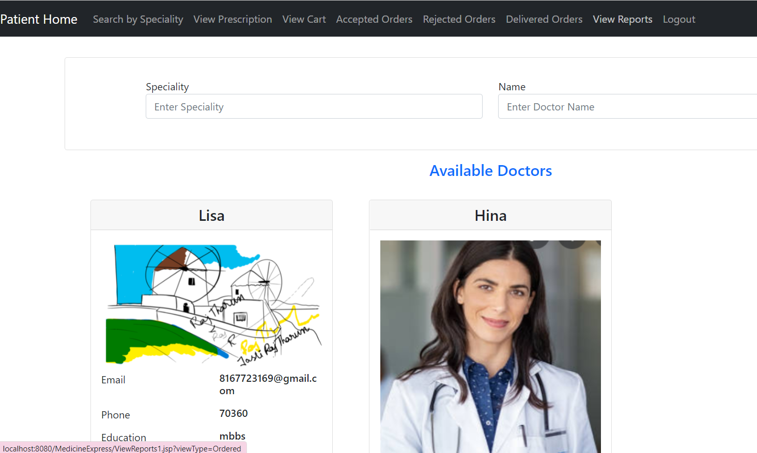
PATIENT ACCESS PAGE

Slide 21
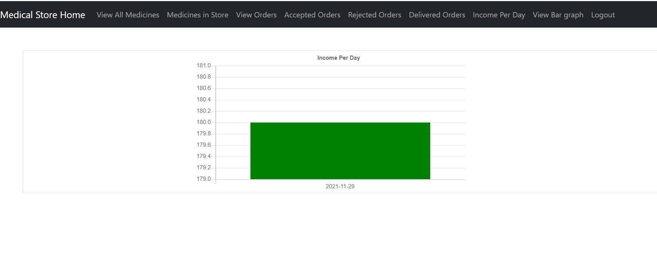

Slide 22
References
http://www.cs.sjsu.edu/~pearce/oom/ood/distArch/server
https://www.topcoder.com/blog/architectural-patterns-to-consider-for-building-enterprise-applications/
https://www.titanwolf.org/Network/q/804fe0f0-7b68-41d5-a2aa-d81221728fa0/y
Course Slides
Text Book

Slide 23
THANK YOU
Any Questions ?

